Slide 1
RS GROUP OF RESTAURANTS
RS GROUP OF RESTAURANTS
Submitted to Manish sir

Slide 2
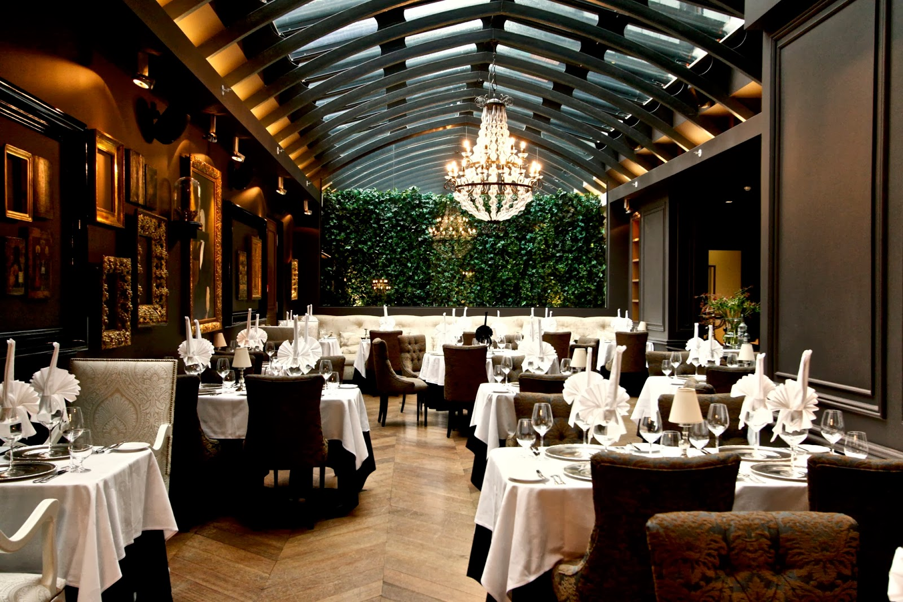
About
About
Situated on the exotic goa beach. RS restaurant is the one of the finest live and dine restaurant with 100+ branches all over the India.
We offer 40 luxury bedrooms with 24/7 room service and dine in facility.
This Photo by Unknown Author is licensed under CC BY-NC-ND

Slide 3
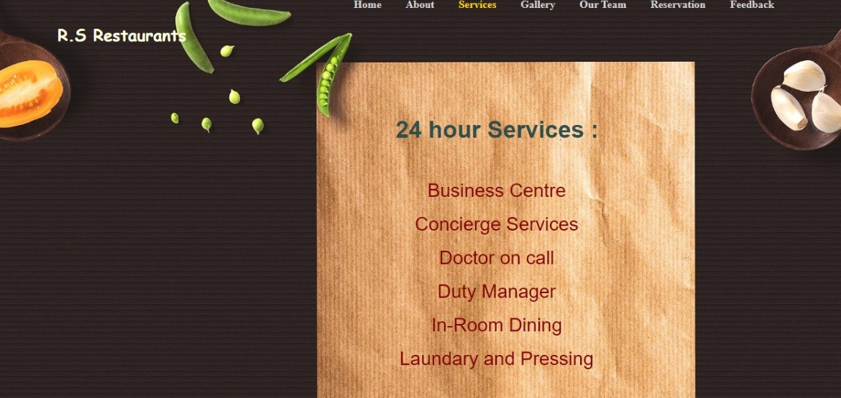
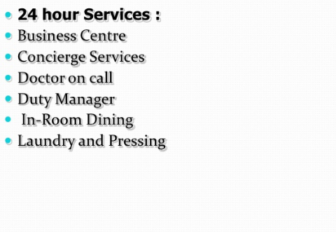

Slide 4
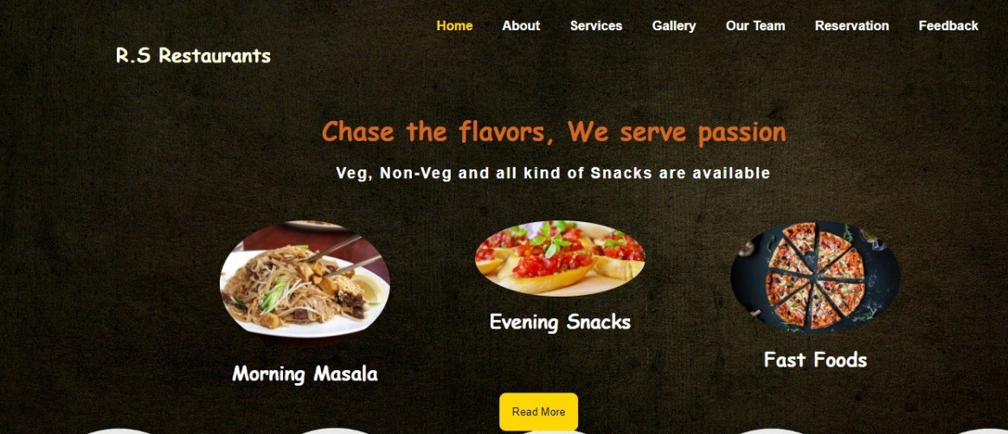

Slide 5
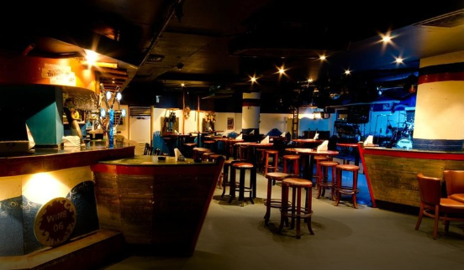
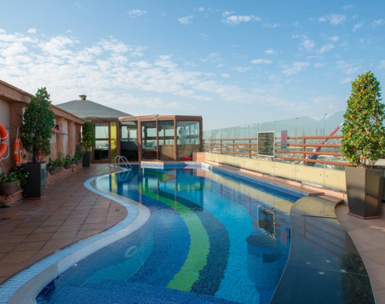
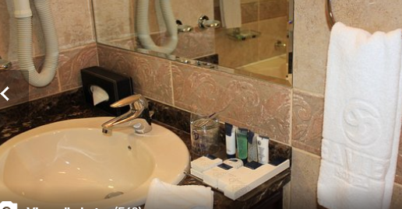
Hotel gallery
GALLERY

Slide 6
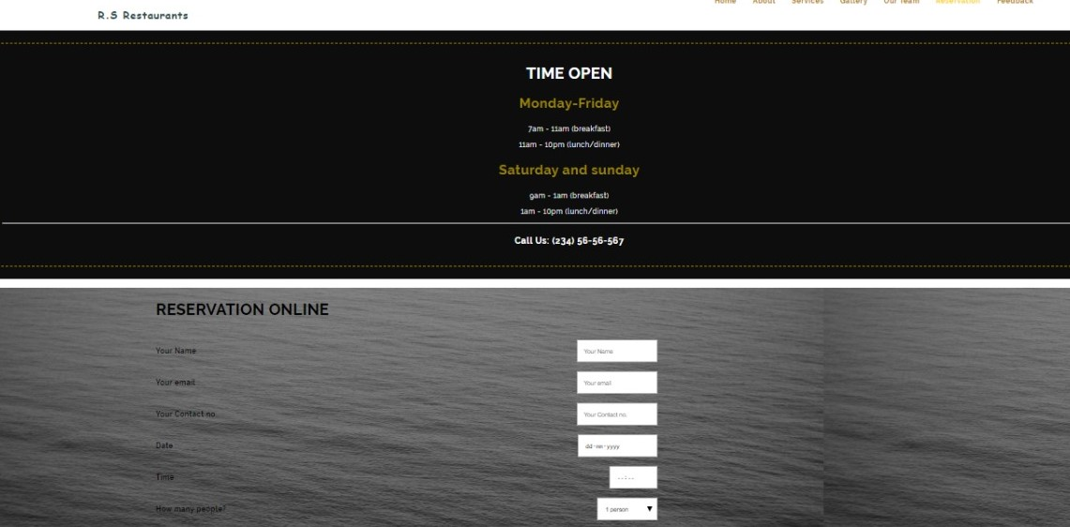

Slide 7



ROLE OF INDIVIDUAL
Methods used
RUDRAMANI DUBEY
CEO
SHUBHAM KUMAR JHA
PRESIDENT
HTML CSS AND JAVASCRIPT
This Photo by Unknown Author is licensed under CC BY-SA
This Photo by Unknown Author is licensed under CC BY-SA
This Photo by Unknown Author is licensed under CC BY-SA

Slide 8
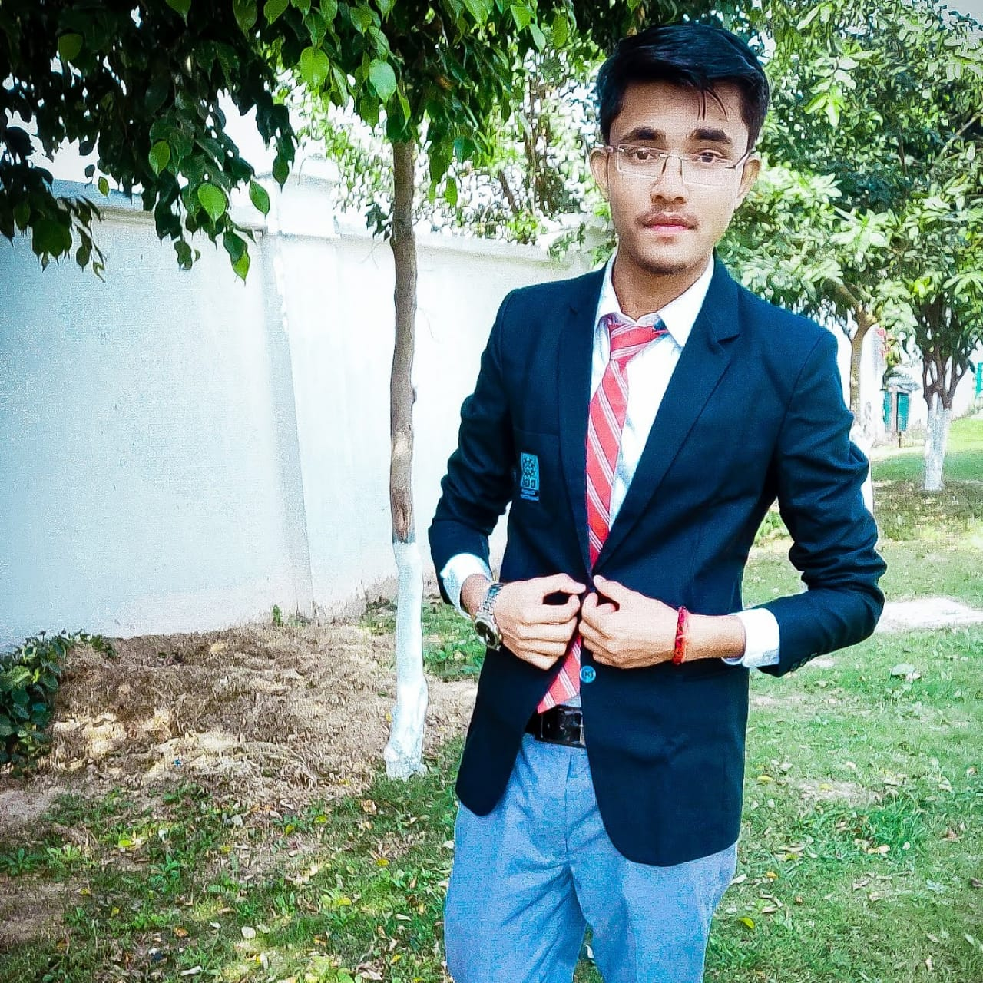
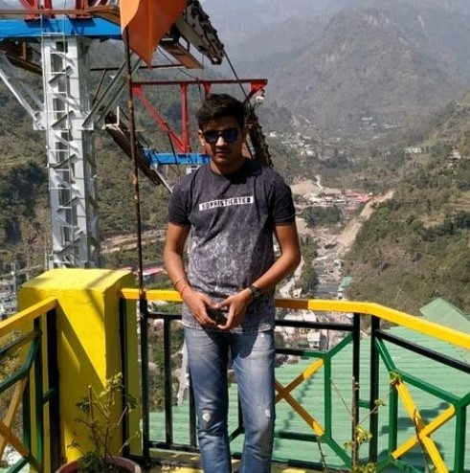
Our team

Slide 9


Slide 10


Slide 11

Contact us at-9009001212 email-rsgoa@gmail.com
SHARE YOUR VALUABLE FEEDBACK

Slide 12
PREPARED BY
Shubham kumar jha
Rudramani dubey

